Slide 1

generative ai: open source vs enterprise
NAVIGATING THE FUTURE OF AI INNOVATION
Ruth Akintunde Ph.d.

Slide 2


Transformative
force of
generative ai

Slide 3

growing up in Nigeria
I witnessed firsthand the country's thriving tech revolution

Slide 4

Open-source technology has significantly improved the tech landscape in Africa

Slide 5


innovation and community collaboration
Open-Source GenAI
Enterprise GenAI
Open-Source GenAI fosters a global ecosystem. Its transparent and collaborative environment accelerates progress, enabling rapid iterations and breakthroughs that might take years within closed systems.
Enterprise GenAI is often developed behind closed doors by tech giants with vast resources. It limits the influence of the broader research community. This exclusivity can slow down cross-industry innovation.

Slide 6
Accessibility
and CosT
Open-Source GenAI
Enterprise GenAI
Anyone with the right knowledge and computing power can leverage open-source GenAI models, adapt them, and build upon them.
These models are often locked behind paywalls. However, businesses that prioritize efficiency and a ready-to-use solution may find enterprise GenAI the more practical choice.

Slide 7
Security, Transparency and Ethical AI
Open-Source GenAI
Enterprise GenAI
Despite bad actors, open-source GenAI allows for community-driven audits, reducing the risks of biased algorithms and enabling more ethical AI governance.
Enterprise GenAI models offer robust security measures, compliance with regulatory requirements, and dedicated teams focused on risk mitigation.

Slide 8




a hybrid approach?
RAG is Not Enough
Agentic Tools
Privacy and Compliance
Multi-Agent Systems
Where RAG is not enough, many organizations are adopting a hybrid approach, leveraging the flexibility of open-source LLMs by fine-tuning them for custom mission-critical applications that require control...
...while integrating enterprise solutions such as Function Calling & Plugins due to their scalability, minimal downtime and ease of use.
A synergy where open-source LLMs can process confidential data in-house e.g. internal document summarization, while enterprise LLMs can handle task that requires adhering to strict data protection laws.
A large workflow where open-source LLMs handle some segments such as data collection and analysis, while the enterprise LLM manages customer communication and end user reports.

Slide 9
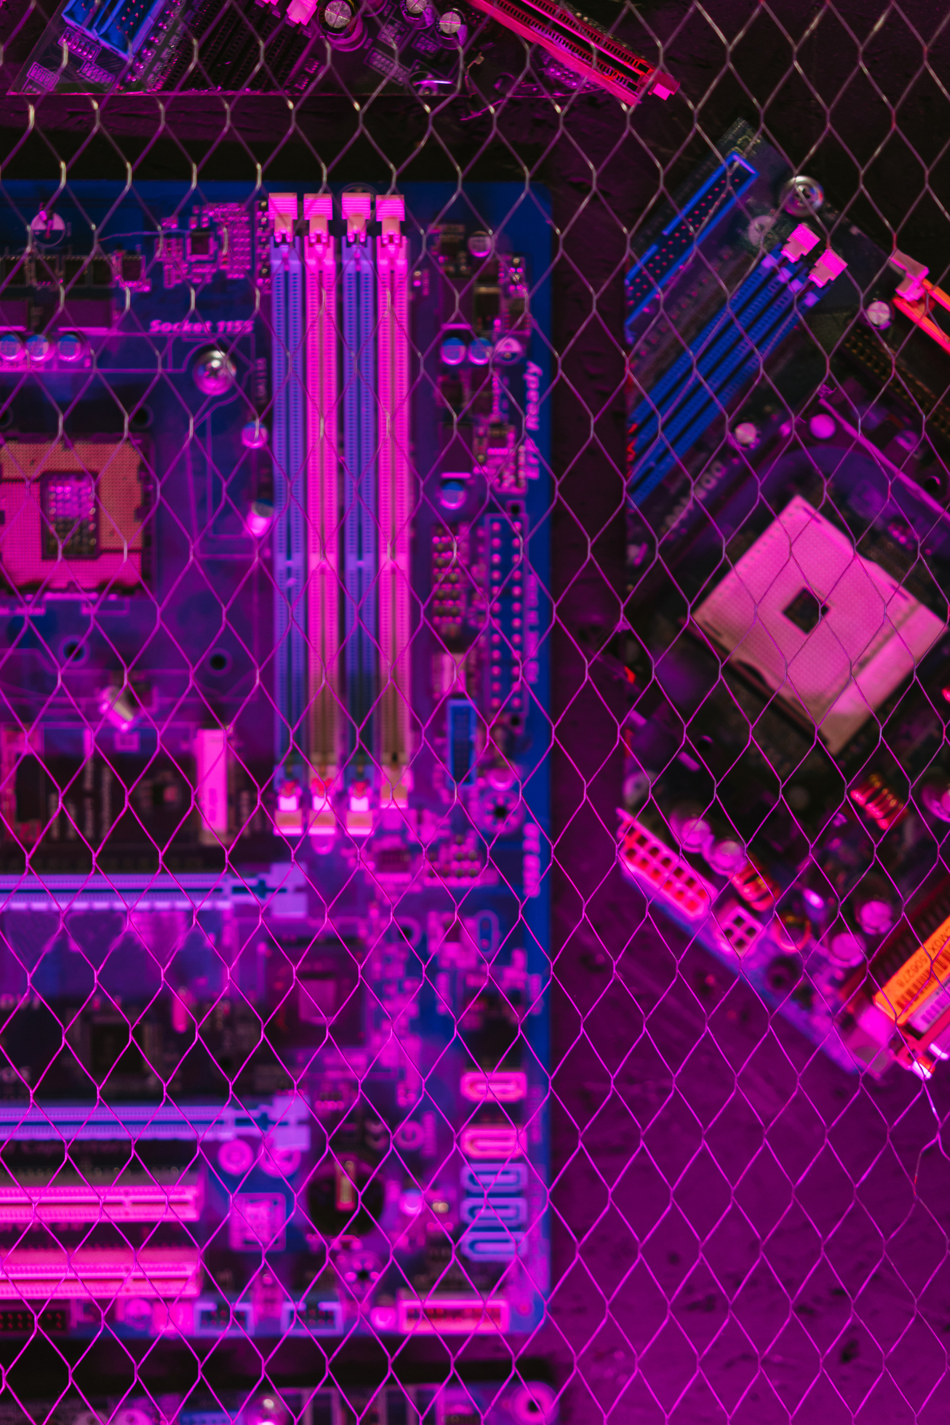
The Future:
a hybrid approach
The answer lies in a future where both open-source GenAI and enterprise GenAI coexist, complementing each other to drive AI forward.

